Slide 1
Onrr.gov dev site study
Summary
July 2022

Slide 2
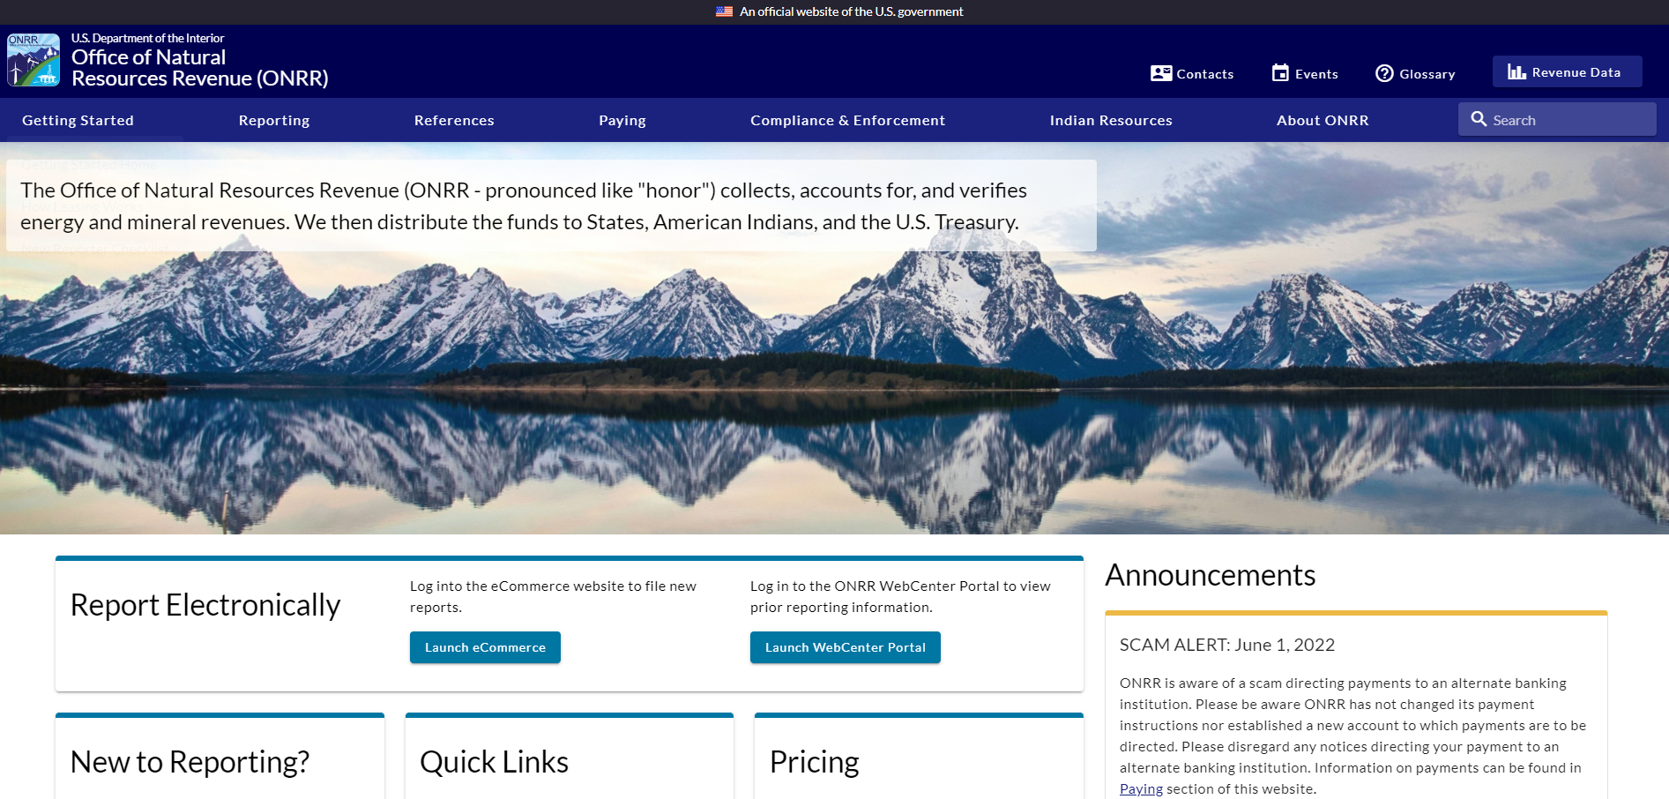
Background
We want to test the usability of the redesigned onrr.gov.
We want feedback on the built dev site to learn whether anything we didn’t anticipate will cause problems for users.

Slide 3
Goals
Learn about any usability issues in the built site.
Gauge whether the new site is effective at allowing users to complete their tasks.
Method and Desired Participants
Over the course of a few weeks, we would like to interview at least 9 participants from the following user groups for 30 minute 1:1 interviews. We will focus on people who actually use the site because they will have real questions that they look for the site to answer. We would like to get a mix of participants from across all the user types.
Subject Matter Expert
Reporter
Inquisitor
Partner

Slide 4
Overview
16 people interviewed
2 Reporters (P1, P3)
6 SMEs (P2, P4, P7, P12, P13, P14)
4 Partners (P6, P9, P15, P16)
4 Inquisitors (P5, P8, P10, P11)

Slide 5
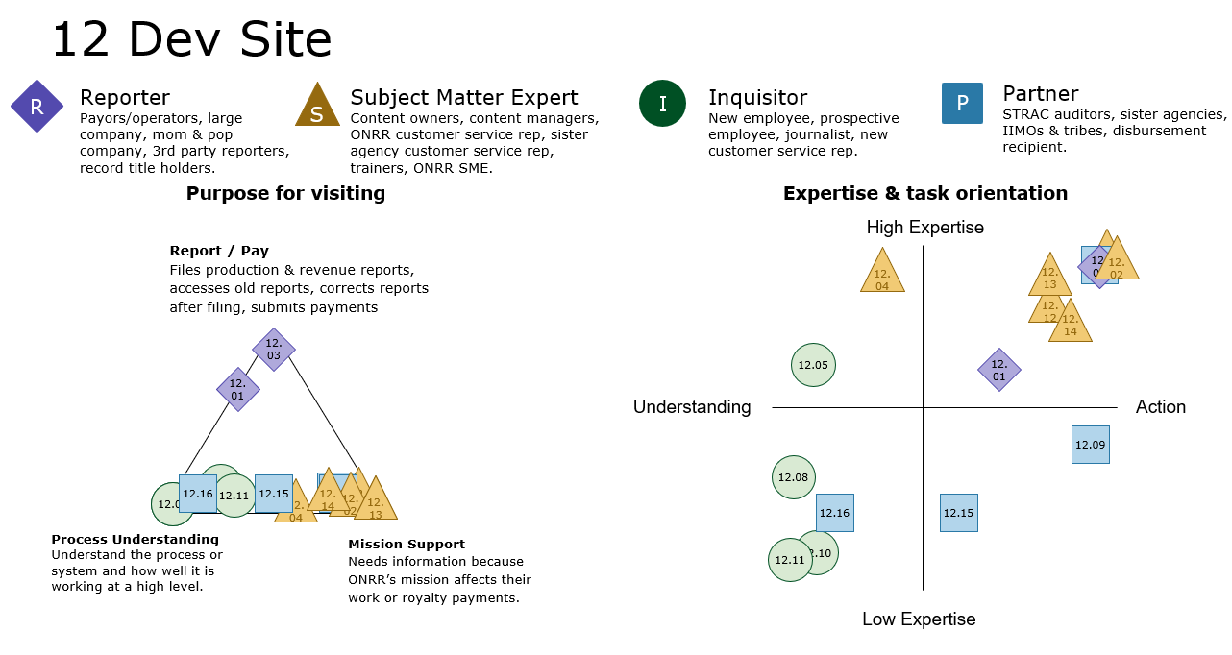
Overview

Slide 6
Findings and Recommendations

Slide 7
Participant Recruiting
Finding:
We struggled to get industry reporters to participate in this study. We had a great turnout for SMEs, Partners, and Inquisitors though.
Recommendation:
Develop better methods to get industry participation.
Severity: Medium
Complexity: Medium
Status: After site launch

Slide 8
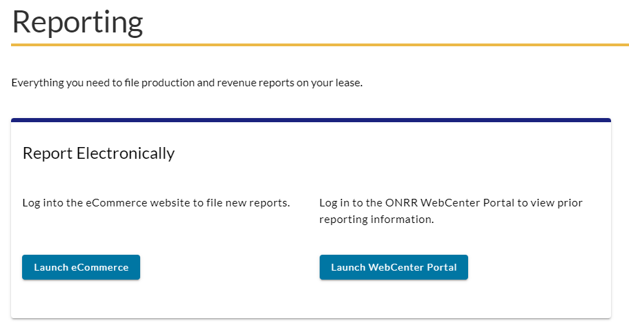
Sites other than onrr.gov – eCommerce and WebCenter Portal
Finding:
There is general confusion about how WebCenter Portal and eCommerce are related to onrr.gov. Some industry participants are not aware that these sites are separate and different from onrr.gov.
The links we had for some of the buttons were routing to a confusing Oracle login page.
Recommendation:
Update the links in the “WebCenter Portal” and “eCommerce” buttons.
Severity: Medium
Complexity: Low
Status: Complete

Slide 9
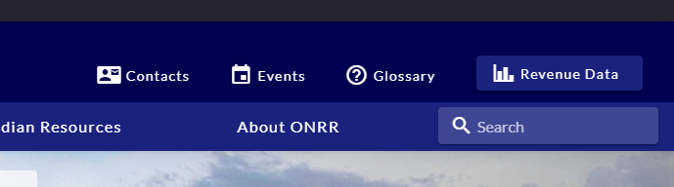
Sites other than onrr.gov – NRRD
Finding:
While NRRD is separate from onrr.gov, users had suggestions on how to improve the site.
Many users were happy to see that the NRRD link will still be in onrr.gov, and several mentions about how they like the NRRD query tool.
Recommendation:
NRRD site suggestions will be addressed after onrr.gov goes live.
Severity: Low
Complexity: Low
Status: After site launch

Slide 10
Site Navigation - General
Finding:
Most users already have the webpages they need either bookmarked or printed out. While they don't do much navigation on the current site, they say the new site is easy to navigate.
One user would like the main tabs in the Primary Nav to open the section (instead of having to click the "Location Home" option).
Another user recommended making the left nav "sticky“
Recommendation:
Make sure all redirects are working so those with bookmarked pages will be properly redirected.
Make an issue for developers to make the left nav "sticky"
Severity: Low
Complexity: Medium
Status: After site launch

Slide 11
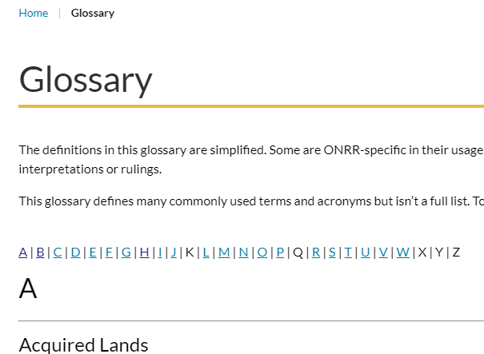
Site Navigation – Search
Finding:
Users really wanted to use the site-wide search, but that will not be operational until the site goes live.
Users like the smaller search fields in reporter letters, handbooks, and contacts.
Users would also like to see a search specific for the glossary.
Recommendation:
Add a search functionality to the glossary.
Severity: Low
Complexity: Low
Status: After Launch

Slide 12
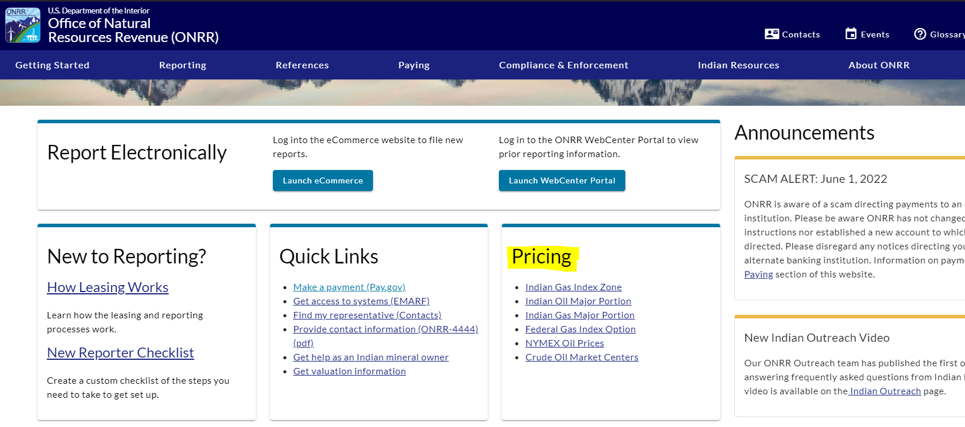
Site Navigation – Pricing
Finding:
Some users felt that the pricing info was "buried" under Reference-Valuation.
We added a pricing card to the homepage and users really like this addition.
Users also really like and appreciate having the pricing maps on their respective pricing pages.
Users also appreciate Indian Pricing being in multiple locations.
Recommendation:
Added a pricing card with links to all pricing pages on the homepage
Severity: Low
Complexity: Low
Status: Complete

Slide 13
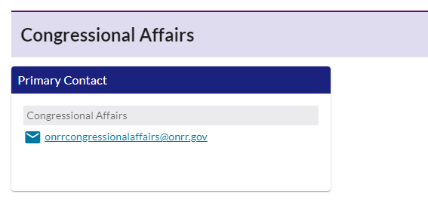
Contacts
Finding:
Users overall like the contacts pages/layouts, and were able to easily navigate to them.
One user wanted to see a specific contact added to the Solid Minerals contacts.
One user had suggestions on making the “Congressional Affairs” wording more uniform.
Recommendation:
Add solids valuation contact card.
Update Congressional Affairs contact card.
Severity: Low
Complexity: Low
Status: Complete

Slide 14
Interactive Handbooks
Finding:
Most users easily found the handbooks and the interactive links. Users like having multiple options to view and share the handbooks.
Another user had an issue using the Table of Contents hyperlinks due to having an Adobe Acrobat plugin for Chrome.
Recommendation:
Add a note above the Tables of Contents noting that the plugin may affect usability.
Severity: Low
Complexity: High
Status: After site launch

Slide 15
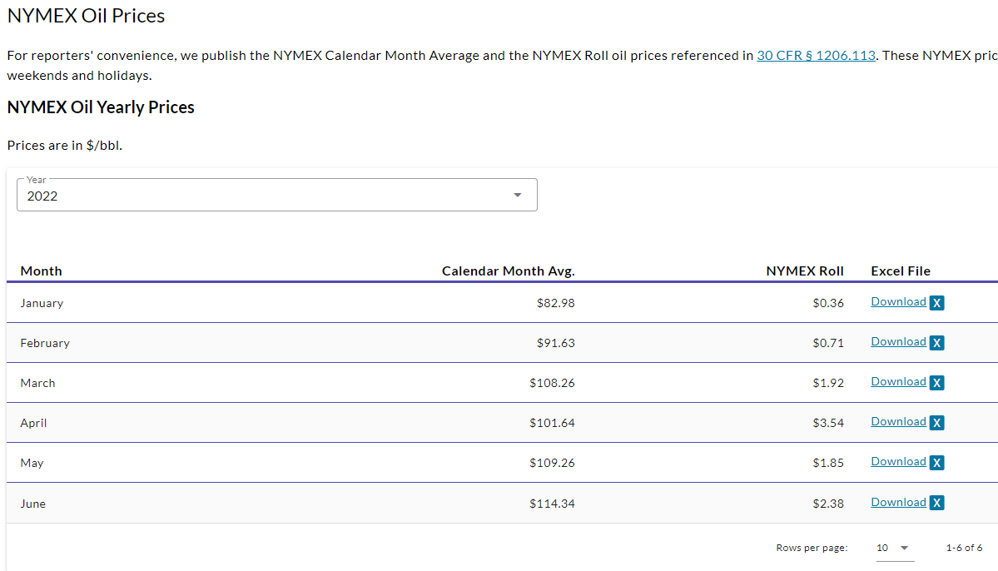
Table Design
Finding:
Users overall appreciated the new tables and sorting/filtering functionality.
Some users noticed inconsistencies on the default organization of tables.
One user did not like the horizontal scroll in the Indian Oil Major Portion pricing table.
Recommendation:
Make pricing tables default to the same sorting methodology.
The scroll is a function of having a smaller screen dimension. Work with developers to better fix resolution issues.
Severity: Low
Complexity: Medium
Status: After site launch

Slide 16
Pricing (webpages)
Finding:
Users overall really like the pricing redesign. Notably, users like having the pricing maps on the pricing pages and having multiple locations for the pricing pages.
One user would like to export the pricing tables to an excel.
Recommendation:
Make a developer issue for getting the pricing tables to export to excel.
Severity: Low
Complexity: Medium
Status: After site launch

Slide 17
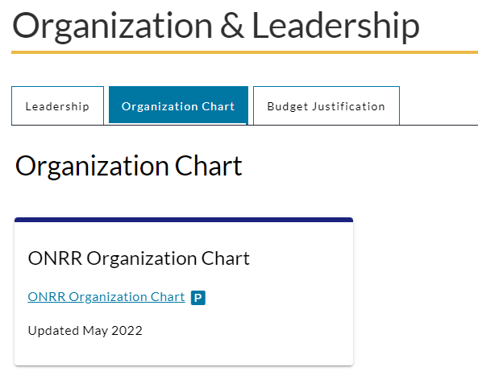
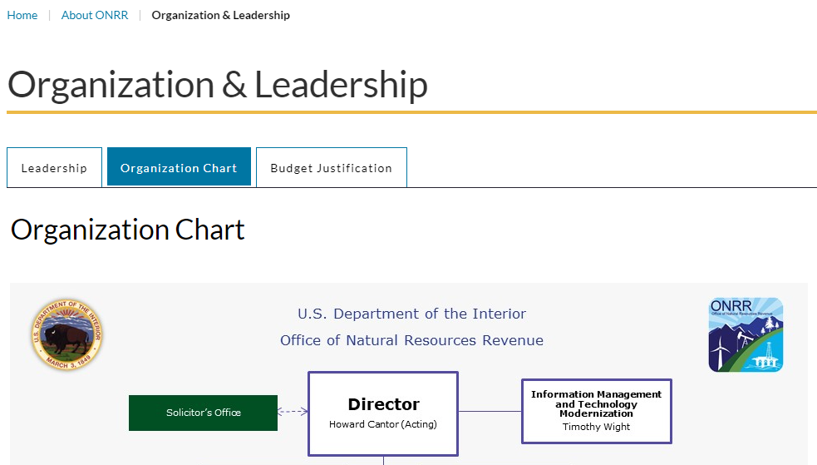
About ONRR (webpage)
Finding:
Several users easily navigated to the org chart and like to view it.
One user did not like that it was a PowerPoint and thought it should be a separate webpage.
Recommendation:
Make the org chart an image to include on the page with the PowerPoint link
Severity: Low
Complexity: Low
Status: Complete

Slide 18
General Criticism
Finding:
One user didn’t particularly like scrolling or the hero images.
One user wants the entire site rebranded to appeal to the general public.
Another user is worried about information getting "hidden" in second level tabs.
Recommendation:
Discuss making the hero images to something more ONRR specific
Discuss making the hero images smaller to reduce scrolling
Severity: Low
Complexity: Low
Status: After site launch

Slide 19
Findings that do not require action items

Slide 20
General Positive Comments
Users gave a lot of general positive comments about navigation, organization, and overall design.
"I wish BLM had a site like this“
“On the whole contacts is very clear and where you would want it to be on a modern-day website.”
“This is all actually really helpful.”
“It’s a tidy layout.”
"Seems user friendly“
“This is easier than the way I was doing it”
“This is easy to access”
“Everything is one place, that’s awesome”
“The site is smooth and seems quite fast.”
“It’s extremely helpful. I like where it’s going.”

Slide 21
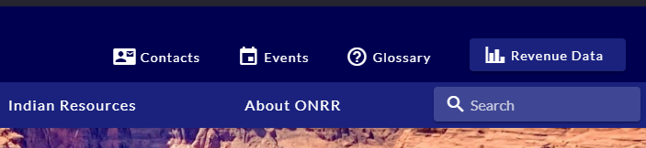
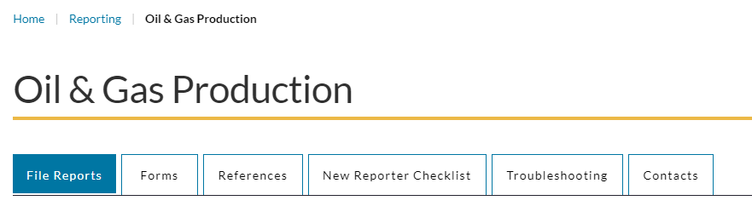
Contacts
Some users easily found the contacts via the top menu icon.
Others would find contacts through the subject pages.
Having the contacts in multiple locations makes sure all users easily find what they are looking for.

Slide 22
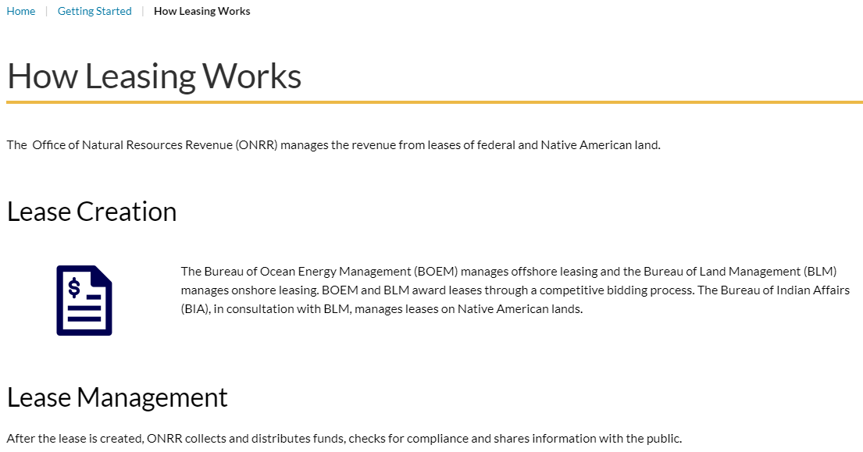
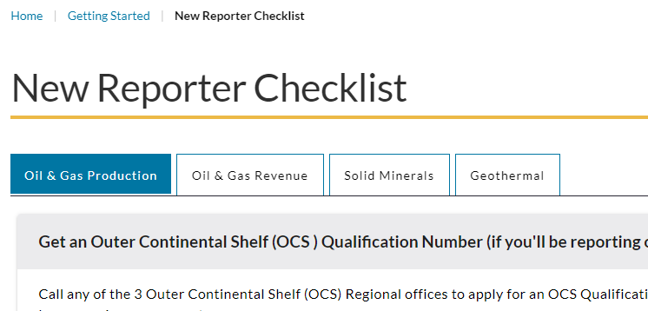
Educational Materials
Users were able to easily find the reporter training and like it.
User like the new educational pages – How Leasing Works and How Valuation Works.
Users were able to easily find valuation examples and wanted to share them with their teams.
Users like the new reporter checklist and think it's very clear and easy to understand.
Most users easily found the handbooks and the interactive links.
Users like having multiple options to view and share the handbooks.
Most users like the troubleshooting guides, but one user was surprised to see it first before contacts.

Slide 23
Questions?

